Slide 1
Debrief 28/03/23

Slide 2



Week 3: Meeting Project Sponsor (Research, Submit Project Proposal)
 | Monday 27 March | Tuesday 28 March | Wednesday 29 March | Thursday 30 March | Friday 31 March
10.00am to 12.30pm | Corporate Project Meeting Project Sponsors 1 | Corporate Project Project Proposal Preparation | Corporate Project Domain Crash Course: Workshop on Digital Marketing | Corporate Project | Digital Skills Learning
12.30pm to 2pm | Lunch Break | Lunch Break | Lunch Break | Lunch Break | Lunch Break
2pm to 4.30pm | Corporate Project Project Proposal Preparation | Corporate Project Project Proposal Preparation | Corporate Project Domain Crash Course: Workshop on Sustainability | Corporate Project | Digital Skills Learning
Project Proposal Submission to TomoWork
Project Proposal Submission to Sponsor
Consult on your TomoWork’s Got Talent Item with Pepper + Interns before submitting the required documents (due on 3 April, Monday).
In-person session at
Republic Polytechnic
Work From Home (WFH)
Flexible arrangement
Company Visit

Slide 3
Programme for 29th March 2023 (Wednesday)
Time | Event | Venue
9.50am | Report to Republic Poly | E1 6T
10am | Workshop on Digital Marketing | E1 6T
12.30pm – 2pm | Lunch
2pm – 4pm | Workshop on Sustainability | E1 6T
4.15pm – 4.30pm | Debrief | E16T
Note:
A gastric flu bug + Covid is on the rise again.
Be mindful of your hygiene. Wash your hands.
To clean up the table at the end of the day using antiseptic wipe.
Things to Bring: Laptop with Charger, money for lunch, writing materials and handphone, YOUR NAME TAG
Wear: Smart Casual

Slide 4
TGT Required Documents
Completed Slides + Script
Practice Video
Music/Lyric Videos
Deadline: 3 April 2023 (Monday)

Slide 5
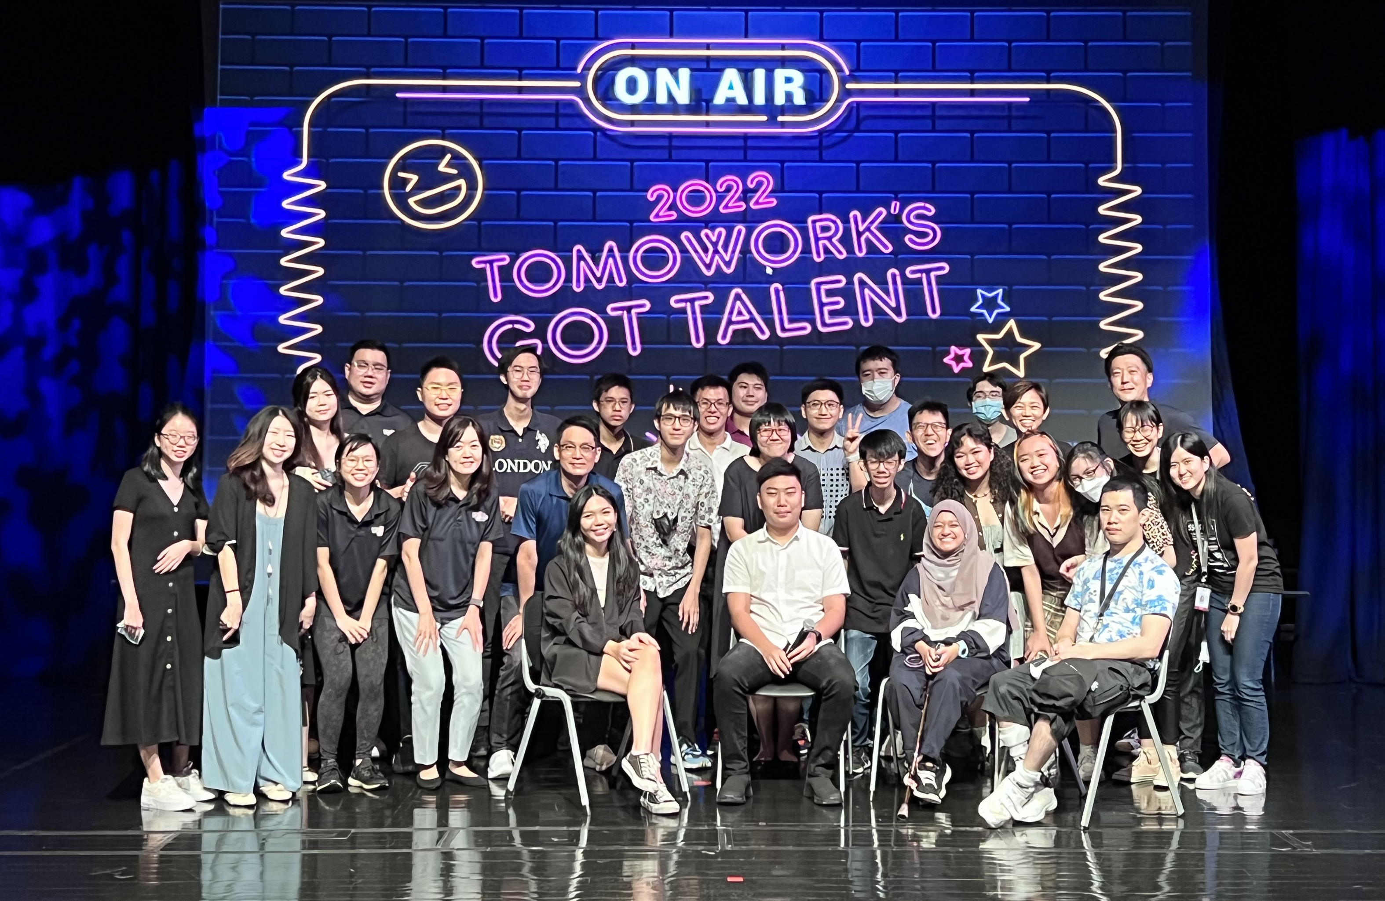
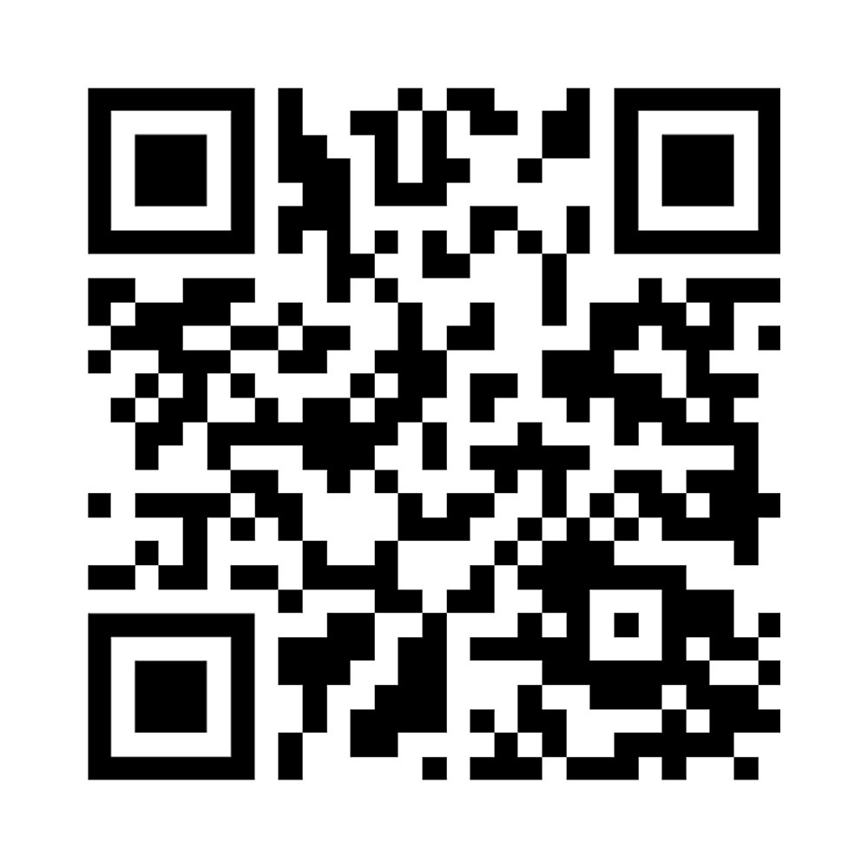
Submit TomoWork’s Got Talent Application (By Today) here:
https://tomowork.typeform.com/to/rIKEkJOm
Submit TomoWork’s Got Talent Practice Video here by 3 April Monday:
https://drive.google.com/drive/folders/1EZ7bUDGOdTUaKZPnGHp53bQxBNxdZypp?usp=sharing

